Slide 1
Econ 100 Principles of Economics
Lecture 11
Apirl 3

Slide 2
TODAY
Supply (cont’d)
Supply and demand together, equilibrium

Slide 3
Supply
Supply is a relationship between two specific variables: Price and quantity supplied
while a number of other relevant variables are kept constant, e.g.
Input prices
Technology
Expectations
Quantity supplied of a good is the amount of that good that sellers are willing and able to sell.

Slide 4
Supply
The supply curve gives the relationship between price and quantity supplied, assuming that all other determinants of quantity supplied are kept constant.
The Law of Supply: Other things being equal, the quantity supplied of a good rises when the price of the good rises.
Remark: A change in the price of a good will cause a change in the quantity supplied of that good, but will not cause a change in the supply for that good.

Slide 5
Defending the law of supply
Revenue is the unit price of the product multiplied by the amount sold. (If you sell 5 units at a unit price of $3, your revenue will be $15.)
A change in price changes revenues and hence profits, so it is a major determinant of the amount sellers will want to sell.
Because a higher price leads to higher profit, and a higher profit leads to a larger amount that sellers will want to sell, we expect that a greater quantity is supplied when the price is higher.
Thus, the relationship between quantity that sellers will sell and price should be direct or positive.

Slide 6
Example: Finding the supply curve
A small t-shirt factory uses one machine (leased at £20 a week) to produce t-shirts. The machine is operated by one worker and produces 1 t-shirt per hour.
The worker is paid £1 per hour on weekdays, £2 per hour on Saturdays , and £3 per hour on Sundays. Working day is max 8 hours by law. (strictly enforced.)
All other costs, such as raw materials, electricity, etc., are £1 per t-shirt.

Slide 7
Question #4
How many t-shirts will be supplied if Benetton pays £2.5 per t-shirt? _______
How many t-shirts if Benetton pays P = £3.5? _________
How many t-shirts if Benetton pays P = £4.5? _________
How many t-shirts if Benetton pays P = £1.5? _________
How many t-shirts if Benetton pays P = £2.5? _________
Use your answers to prepare the supply schedule. Put these price and quantity supplied figures in a table form with 2 columns. Also draw a price - quantity supplied graph, put these price and quantity supplied figures on the graph and connect the dots with a line. What is the shape of the line?

Slide 8
A small t-shirt factory uses one machine (leased at £20 a week) to produce t-shirts. The machine is operated by one worker and produces 1 t-shirt per hour.
The worker is paid £1 per hour on weekdays, £2 per hour on Saturdays , and £3 per hour on Sundays. Working day is max 8 hours by law. (strictly enforced.)
All other costs, such as raw materials, electricity, etc., are £1 per t-shirt.
Question #4:
How many t-shirts will be supplied if Benetton pays £2.5 per t-shirt? _______
How many t-shirts if Benetton pays P = £3.5? _________
How many t-shirts if Benetton pays P = £4.5? _________
How many t-shirts if Benetton pays P = £1.5? _________
How many t-shirts if Benetton pays P = £2.5? _________
Use your answers to prepare the supply schedule. Put these price and quantity supplied figures in a table form with 2 columns. Also draw a price - quantity supplied graph, put these price and quantity supplied figures on the graph and connect the dots with a line. What is the shape of the line?

Slide 9
Costs at the one-worker, one-machine t-shirt factory
Suppose 45 t-shirts are produced:
Total cost is £20 for the machine, £45 for raw materials, and £50 for labor = £115.
£20 for the machine is called the FIXED cost, because it doesn’t change as we change the number of t-shirts we produce.
The raw material and labor costs are the VARIABLE costs: £95.
£115/45 = £2.55 is called the AVERAGE cost. (aka the UNIT cost).
Suppose we produce one more t-shirt, the 46th.
Then variable costs will go up by £2 (labor) + £1 (raw material) = £3. This £3 is called the MARGINAL cost, or the ADDITIONAL cost of producing one more t-shirt (starting with 45 t-shirts).

Slide 10
P = £2.5 How many t-shirts should we supply?
Let us ignore the machine cost £20 for a moment.
Weekdays 1 t-shirt costs £2. (£1 for labor and £1 for raw material). If the price is £2.5, we make a “profit” £0.5 per t-shirt for weekdays.
So we should produce 5x8 = 40 t-shirts.
This is the profit max quantity and therefore our quantity supplied at P = £2.5.
Why not more?
More t shirts can be produced by also working on Saturday.
But, on a Saturday 1 t-shirt costs £3. (£2 for labor, and £1 for raw material) The price is £2.5, therefore, the “Saturday t-shirts” are not profitable.

Slide 11
Quantity supplied at different prices
When the price is £3.5, then we make a “profit” £0.5 per t-shirt produced on Saturday, but not on Sundays. So, if P = £3.5 the quantity supplied is 40 + 8 = 48 t-shirts.
When the price is £4.5, even the “Sunday t-shirts” are profitable. On Sunday 1 t-shirt costs £4 (£3 for labor, and £1 for raw material). So, if P = £4.5 the quantity supplied is 40 + 8 + 8 = 56.
When the price is £1.5, even the weekday t-shirts are not profitable, so the quantity supplied at that price is 0.

Slide 12
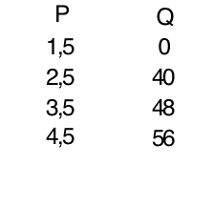
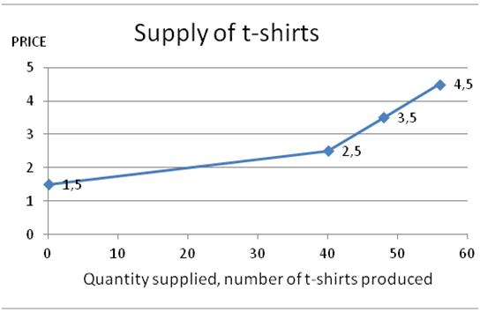
The supply curve and the supply schedule look like this…
Supply schedule Supply curve

Slide 13
So what was the point of all this?
A simple story that gives us an upward sloping supply curve. (A small step towards convincing you that the law of supply makes sense.)
Also, we saw a number of cost concepts:
total cost,
average cost,
fixed cost,
variable cost,
marginal cost

Slide 14
We also saw that the small t-shirt producing firm (takes the price offered by Benetton as fixed and non-negotiable) produces more if P > marginal cost, but not if P < marginal cost.
So at the profit maximizing output level the firm chooses, we have the marginal cost (almost) equal to the price of output.
If you take Econ201 (Intermediate Microeconomics) you will see that a price-taking firm will maximize profit by producing an output level at which Price = Marginal cost.

Slide 15

Now the great moment has arrived
Demand meets supply:
How the prices are determined…

Slide 16
Supply and demand together
Equilibrium refers to a situation in which the price has reached the level where quantity supplied equals quantity demanded.

Slide 17
Competitive markets
My favorite definition: A competitive market is a market where buyers and sellers behave competitively.
So, what is “competitive behavior”?
An agent (buyer or seller) behaves competitively if the agent assumes or believes that the market price is given and that the agent’s actions do not influence the market price.
Also known as “price taking behavior.”
A competitive market is a market in which individual buyers and sellers have a negligible impact on the market price.

Slide 18
Perfect Competition (Perfectly competitive markets)
But why/when do we expect a seller/firm and a buyer/consumer behave competitively?
There are many (numerous) buyers and sellers, and each one is very small relative to the market size.
Goods that are sold by different firms are all the same.
There is perfect information about product quality and prices.
As a result, buyers and sellers are (behave as) price takers.

Slide 19
Competitive markets
The term demand refers to the behavior of consumers, buyers in competitive markets.
The term supply refers to the behavior of producers, sellers in competitive markets.

Slide 20
Supply and demand together
Equilibrium : The price has reached the level where quantity supplied equals quantity demanded.

Slide 21
Supply and demand together
Equilibrium Price
The price at which quantity supplied equals quantity demanded.
On a graph, it is the price at which the supply and demand curves intersect.
Equilibrium Quantity
The quantity supplied and the quantity demanded at the equilibrium price.

Slide 22
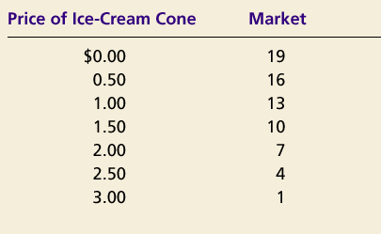
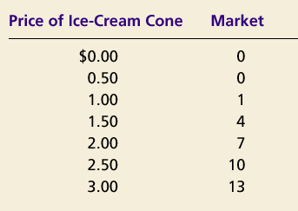
Supply and demand together
Demand Schedule
Supply Schedule
At $2.00, the quantity demanded is equal to the quantity supplied!

Slide 23
Price of
Ice-Cream
Cone
Supply
Equilibrium price
Equilibrium
$2.00
Equilibrium
Demand
quantity
0
1
2
3
4
5
6
7
8
9
10
11
12
13
Quantity of Ice-Cream Cones
Copyright©2003 Southwestern/Thomson Learning

Slide 24
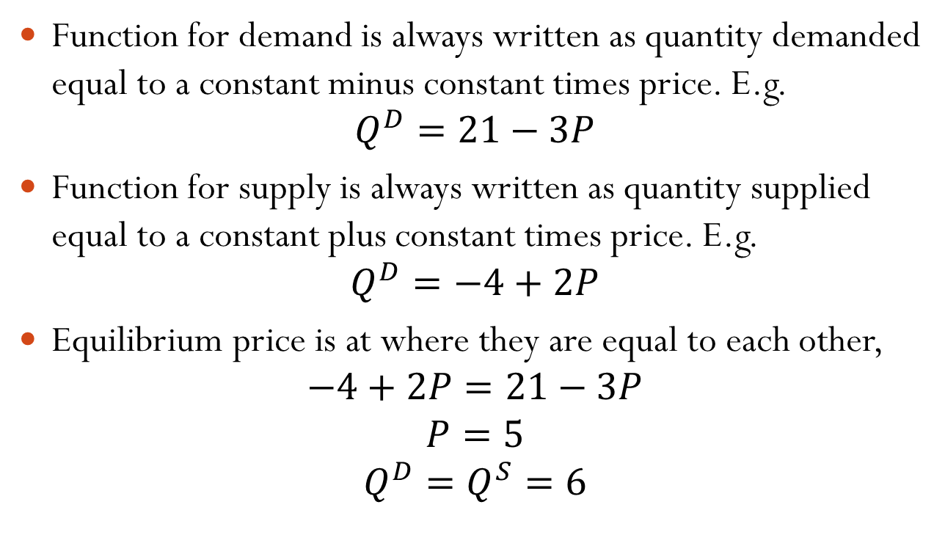
Equilibrium from Demand and Supply Equations
Function for demand is always written as quantity demanded equal to a constant minus constant times price. E.g.
$$Q^{D}=21−3P$$
Function for supply is always written as quantity supplied equal to a constant plus constant times price. E.g.
$$Q^{D}=−4+2P$$
Equilibrium price is at where they are equal to each other,
$$−4+2P=21−3P$$
$$P=5$$
$$Q^{D}=Q^{S}=6$$

Slide 25
(a) Excess Supply
Price of
Ice-Cream
Supply
Cone
Surplus
$2.50
2.00
Demand
0
4
7
10
Quantity of
Quantity
Quantity
Ice-Cream
demanded
supplied
Cones
Copyright©2003 Southwestern/Thomson Learning

Slide 26
Equilibrium
Surplus
When price > equilibrium price, then quantity supplied > quantity demanded.
There is excess supply or a surplus.
Suppliers will lower the price to increase sales, thereby moving toward equilibrium.

Slide 27
The price mechanism works as follows:
If the quantity demanded < the quantity supplied
at the existing market price,
then the market price declines until the excess supply is eliminated.

Slide 28
Figure 9 Markets Not in Equilibrium
(b) Excess Demand
Price of
Ice-Cream
Supply
Cone
$2.00
1.50
Shortage
Demand
0
4
7
10
Quantity of
Quantity
Quantity
Ice-Cream
supplied
demanded
Cones
Copyright©2003 Southwestern/Thomson Learning

Slide 29
Equilibrium
Shortage
When price < equilibrium price, then quantity demanded > the quantity supplied.
There is excess demand or a shortage.
Suppliers will raise the price due to too many buyers chasing too few goods, thereby moving toward equilibrium.

Slide 30
The price mechanism works as follows:
If the quantity demanded > the quantity supplied
at the existing market price,
Then the market price will rise until the excess demand is
eliminated.

Slide 31
Equilibrium: The price mechanism at work
The price adjusts to bring the quantity supplied and the quantity demanded into balance.
Free markets reach equilibrium through the interaction of buyers and sellers and price is the tool through which the market is cleared.

Slide 32
A few words on the meaning of the market equilibrium
Equilibrium:
quantity demanded = quantity supplied
At the equilibrium price all buyers buy as much as they want, there is no shortage. There is not a single buyer who says: I want to buy more of the good but I can't find any.
At the equilibrium price all sellers sell as much as they want, there is no surplus (unsold goods). There is not a single seller who says: I want to sell more of the good but I can't find any buyers.

Slide 33
A few words on the meaning of the market equilibrium
No buyer is absolutely happy: Almost every buyer will be happier if she can buy more of the good at a lower price than the equilibrium price.
What is the price the buyers want best? (Provided that there is enough of the good supplied to satisfy demand at that price.)
The good should be free (price = 0)
No seller is absolutely happy: Almost every seller will be happier if she can sell more of the good at a higher price than the equilibrium price.

Slide 34
This is how the sellers learn the relative desirability (consumption value, benefit to consumers etc) of ice-cream: they learn it through its price.
Prices act as signals that guide the allocation of scarce resources in a market economy.

Slide 35
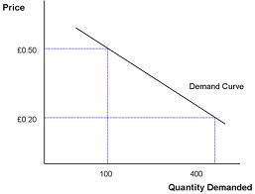
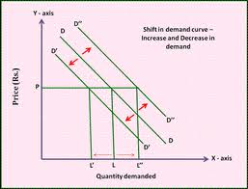
Demand curve
The demand curve shows how the quantity of a good depends on the price.
Law of demand: As the price of a good falls, the quantity demanded rises. The demand curve slopes downward.
In addition to price, other determinants of how much consumers want to buy include income, the prices of complements and substitutes, tastes, expectations, and the number of buyers.
If one of these factors changes, the demand curve shifts.

Slide 36
Shifts versus movements along the demand curve
When the price of the good changes we show the change in the buyer’s desired level of consumption as a movement along a (fixed) demand curve. We call this a change in quantity demanded.
When the consumer’s income, or prices of other goods, etc., change, we show this as a shift in the demand curve. We call this a change in demand.

Slide 37
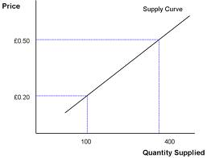
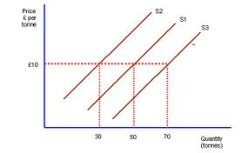
Supply curve
The supply curve shows how the quantity of a good supplied depends on the price.
The law of supply: As the price of a good rises, the quantity supplied rises. The supply curve slopes upward.
In addition to price, other determinants of how much producers want to sell include input prices, technology, expectations, and the number of sellers.
If one of these factors changes, the supply curve shifts.

Slide 38
Shifts versus movements along the supply curve
When the price of the good changes we show the change in production levels as a movement along a (fixed) supply curve. We call it a change in quantity supplied.
When input prices, or technology, etc., change, we show this as a shift in the supply curve. We call it a change in supply.

Slide 39
Now something that is really really REALLY very important

Slide 40
Analyzing Changes in Equilibrium: The three steps method
0. Something (an event) happens: e.g., a meteor hits the earth.
Decide whether the event shifts the supply or demand curve (or both).
Decide whether the curve(s) shift(s) to the left or to the right.
Use the supply-and-demand diagram to see how the shift affects equilibrium price and quantity.

Slide 41
Figure 10 How an Increase in Demand Affects the Equilibrium
1. News says that regular consumption
Price of
of vanilla ice-cream reduces
cardiovascular diseases
Ice-Cream
Cone
Supply
$2.50
New equilibrium
2.00
2. . . . resulting
Initial
in a higher
equilibrium
price . . .
D
Excess demand at P = 2
D
0
7
10
12
Quantity of
3.
. . .
and a higher
Ice-Cream Cones
quantity sold.
Copyright©2003 Southwestern/Thomson Learning

Slide 42
This is what prices do: Prices communicate information
Demand rises: people want more ice-cream.
There must be more production to meet the higher demand.
How can you convince/make the sellers supply more?
They are self interested, they need higher prices to work harder and supply more.
The price must rise to create more supply (raise the quantity supplied)
The “demand-induced-higher-price” is a message from the buyers to the sellers: We want more ice-cream.

Slide 43
This is how the sellers learn the relative desirability (consumption value, benefit to consumers etc) of ice-cream: they learn it through its price.
Prices act as signals that guide the allocation of scarce resources in a market economy.

Slide 44
One more example
A supply shift

Slide 45
Figure 11 How a Decrease in Supply Affects the Equilibrium
Price of
Ice-Cream
1.There is an increase in the
Cone
Excess demand, shortage
price of sugar (a major input
S₂
In the production of ice cream)
S₁
New
$2.50
equilibrium
2.00
Initial equilibrium
2. . . . resulting
in a higher
price of ice
cream . . .
Demand
0
4
7
Quantity of
3.
. . .
and a lower
Ice-Cream Cones
quantity sold.
Copyright©2003 Southwestern/Thomson Learning

Slide 46
Again, prices communicate
Ice-cream production is now more costly.
Demand must be reduced.
How can you make the buyers reduce their consumption?
They are self interested, they respond to prices:
Higher prices will make them consume less.
As the price of ice-cream rises, buyers will reduce their quantity demanded and substitute towards other goods.
Buyers find out about the relative scarcity of a good through its price.
Each individual buyer then decides what to do him/herself; decision making is decentralized.

Slide 48
A real world application World food prices

Slide 49
Food Price Increases
The FAO food price index which covers the prices of the most important food commodities showed a price increase of 71% during the 15 months between the end of 2006 and March 2008.
The increase was particularly dramatic for rice and cereals where the prices sky-rocketed to a peak of 126% in this time period.

Slide 50
Food price increases btw 2006-08
Commodity | Price increase from start 2006 to mid-2008
Maize | 180 %
Wheat | 110 %
Oil | 110 %
Cocoa | 90 %
Coffee | 70 %
Cotton | 30 %
Sugar | 10 %

Slide 51
Food Price Increases
Why did the food prices increase dramatically?
Increasing consumption of dairy products in the developing countries
Agricultural productivity
Production of agro-fuels (ethanol and biodiesel)
The reduction of food stocks (particularly in the EU)
The increase in the oil prices
Weather (La Nina-cooling of equatorial Pacific, flood in Australia, etc.)
Export restrictions on food by governments
Speculation

Slide 52
The food vs. fuel dilemma
A study in demand and supply

Slide 53
The food vs. fuel dilemma is about using farmland or crops for bio-fuels production (mostly ethanol) so as to threaten the food supply on a global scale.
There is discussion about how significant the issue is, what is causing it, and what can be done about it.

Slide 54
But a fair statement of the issue would be that..
The main problem with subsidizing the production of ethanol (bio-fuel) from corn is that it is causing people in low-income countries to go hungry.

Slide 55
From Guardian Sept 2012:
Under laws intended to reduce foreign oil imports, 40% of US maize (corn) harvest must be used to make bio-fuels, even though one of the deepest droughts in the past 100 years is expected to reduce crop yields significantly.
In addition, EU countries are expected to move towards drawing 10-20% of their energy supply for transport from bio-fuels to reduce carbon emissions.

Slide 56
UN FAO director general José Graziano da Silva said suspension of the [biofuel] quota would allow more of the crop to be diverted for food production. "The worst drought for 50 years is inflicting huge damage on the US maize crop, with serious consequences for the overall international food supply," he wrote in the Financial Times.

Slide 57
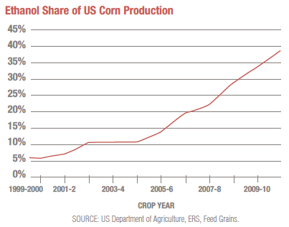
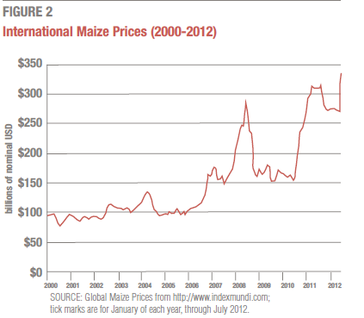
More facts

Slide 58
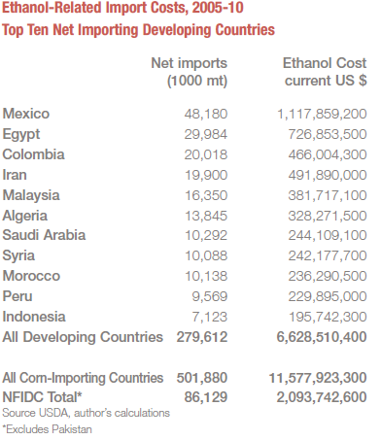
Cost for developing countries
Source
http://www.ase.tufts.edu/gdae/Pubs/rp/ActionAid_Fueling_Food_Crisis.pdf

Slide 59
Food Price Increases
Before we analyze the case of biofuels, let us consider the effect of weather (La Nina-cooling of equatorial Pacific, flood in Australia, etc.).
Price of
grain
S₂
S₁
E₁
E₀
D
Quantity of grain

Slide 60
Food Price Increases
pp
Let us consider the effect of using farmland or crops for bio-fuels production on the food price.
Some portion (40%) of the total production is allocated for bio-fuels. How?
Price of
grain
S
p₀
E₀
D
q₀
Quantity of grain

Slide 61
Food Price Increases
Let us consider the effect of using farmland or crops for bio-fuels production on the food price.
Some portion (40%) of the total production is allocated for bio-fuels.
Price of
grain
S
E₁
p₁
p₀
E₀
D
q_{food}
q₁
Quantity of grain

Slide 62
Food Price Increases
Other factors:
agricultural productivity,
the reduction of food stocks (particularly in the EU),
the increase in the oil prices,
export restrictions on food by governments,

